Slide 1
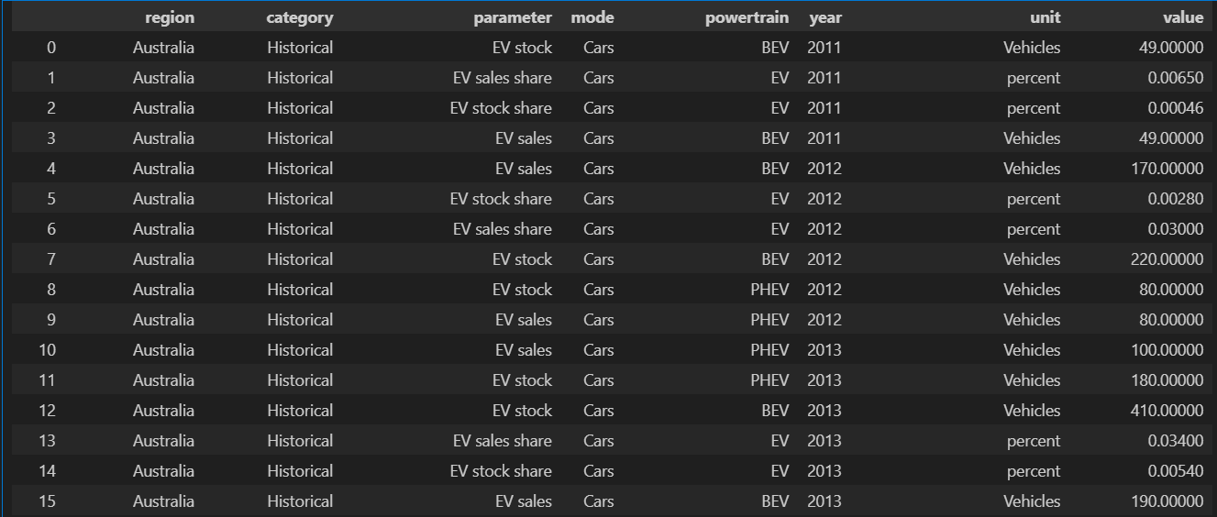
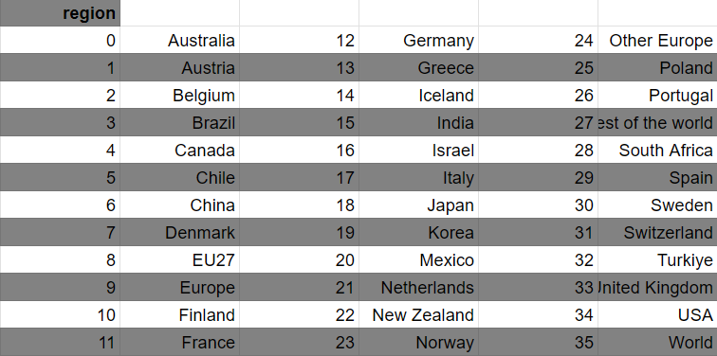

Data Ex:
Project Built on
data

Slide 2
Battery Research Allocation by Auto Trends
A Data Driven Approach

Slide 3
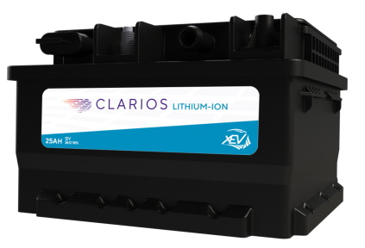
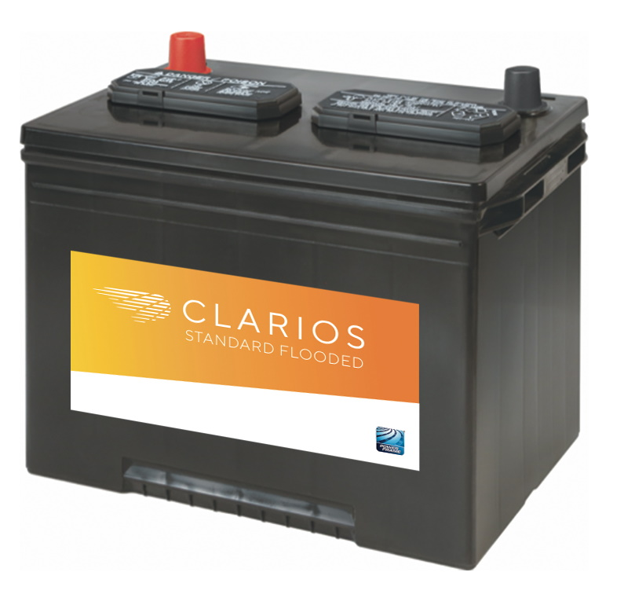
Changing Times, Changing Research Allocations
Lithium Ion VS Lead Acid

Slide 4
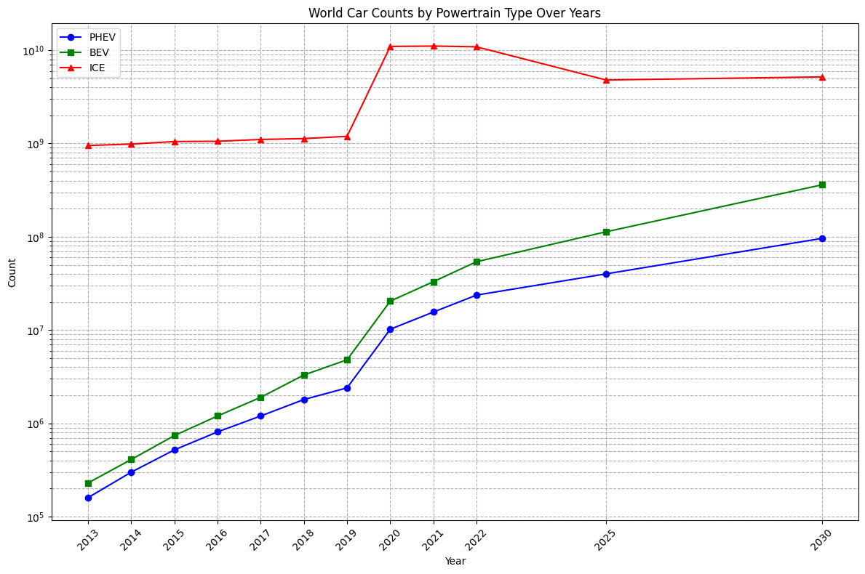
EV, Hybrid(PHEV), ICE cars over the years
Different Battery types and sizes
More profit on EV then Hybrid then ICE
Clarios only care about batteries so use (KWH) to equalize comparisons
How important is flooded?
Overrepresented?

Slide 5
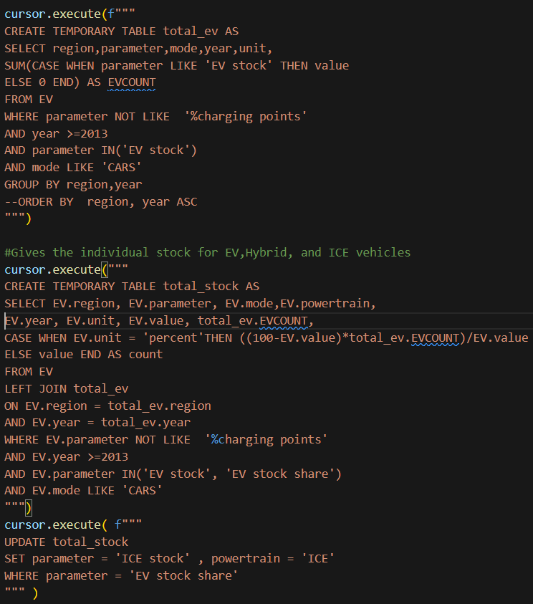
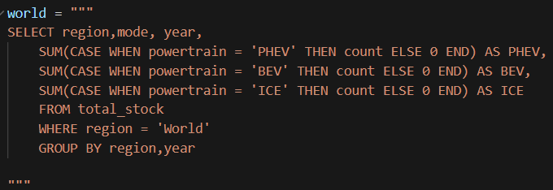
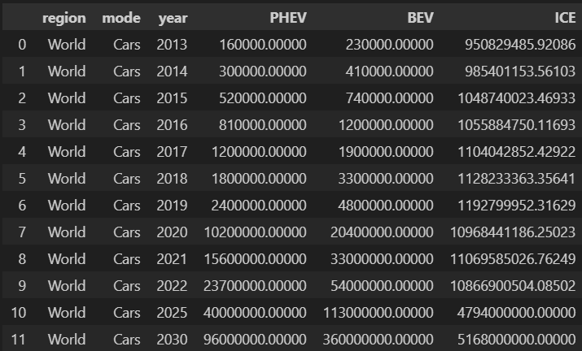
Sources, Code, Data
Precursor Queries:
Used IEA
sqlite3,pandas, matplot,numpy
SQL Concepts: Left join, update, pivoting, case, aggregate functions, temporary table
World Car Count by Powertrain(Graph):
Data:

Slide 6
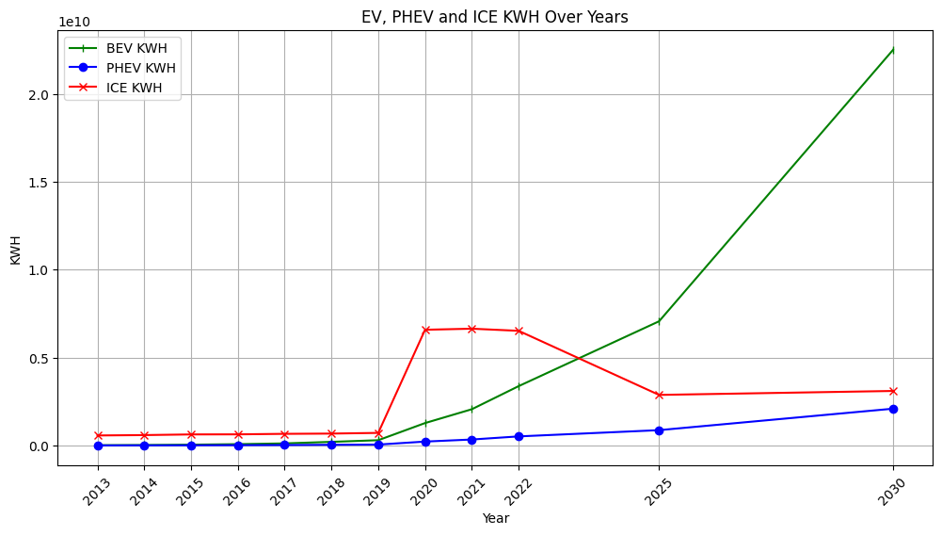
EV, Hybrid(PHEV), ICE KWH over the years
Looking at KWH we see battery sales is way high for EVs
Clearly it is becoming more useful to focus on EV, Li batteries than Flooded or AGM
But by how much?
What Ratio Li & Lead Acid?

Slide 7
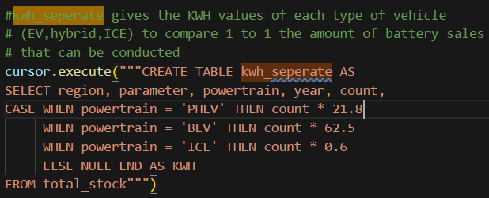
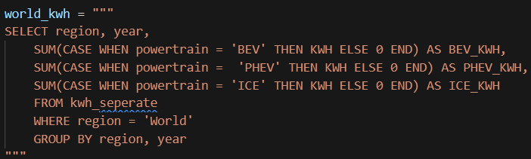
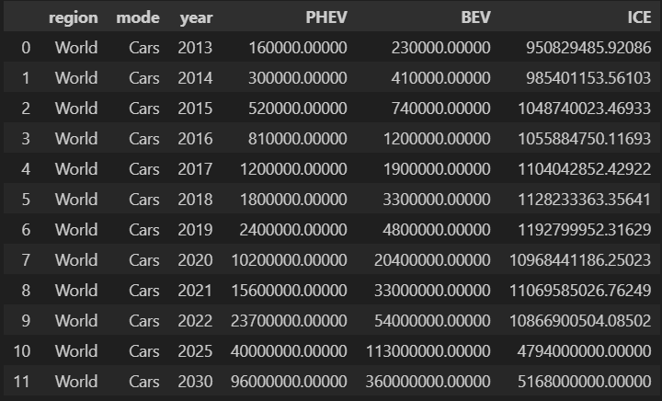
Code
Precursor Queries:
World KWH by Powertrain(Graph):
SQL Concepts: Pivoting, row arithmetic, case in aggregate functions.
KWH Averages:
PHEV 21.8 KWH per car
BEV 62.5 KWH per car
ICE(Starter battery) 0.6 KWH per car

Slide 8
Research Percentage?
As a battery company battery sales is very high on EV even if amount of EV as total amount of cars isn’t high
PHEV and BEV use different amounts of Li battery so calculations account for that
Still need the edge in Lead Acid Batteries
Need to find the right percentage of research in Li and Lead Acid
LI/Lead %

Slide 9





Different Allocations for Different Companies
Lithium Ion VS Lead Acid Per Brand

Slide 10
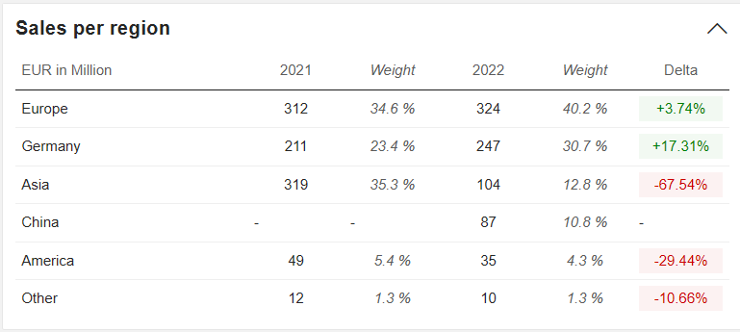
Different Sales for Different Regions
Varta:
Varta has public sales so used that to weigh each regions Li/Lead % by the weight listed above
Heliar, LTH, Optima, Delkor:
Issues:
No public sales
Data missing for some smaller countries
Used the major countries to represent the regions
ex.South America represented by chile and Brazil

Slide 11
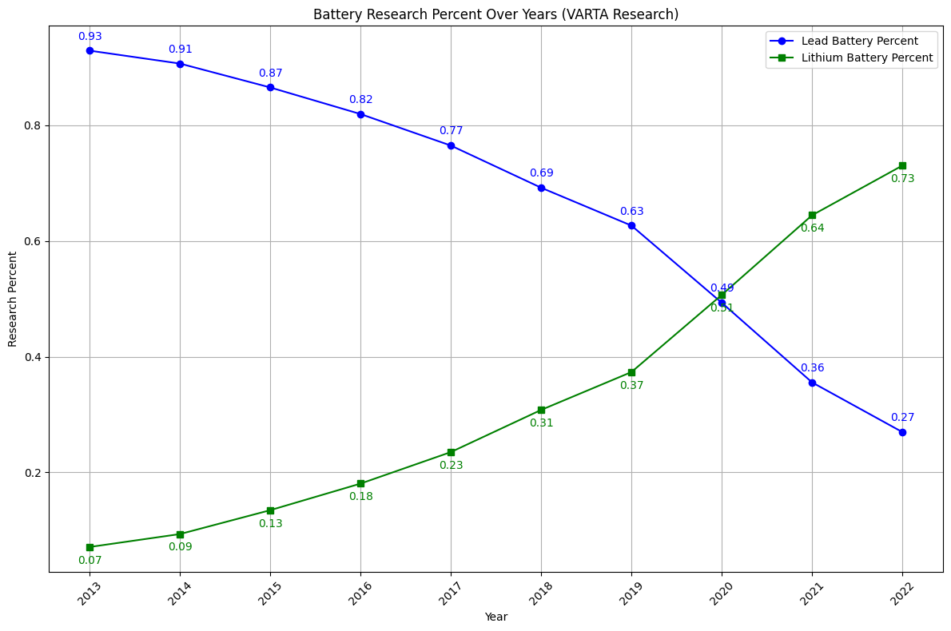
Varta Research Ratio
Varta sale figures is being used to weigh the data of each particular region to fit the best ratio for their clientele
Weights:
Europe | 40.2
Germany | 30.7
Asia | 12.8
China | 10.8
America | 4.3
World | 1.3

Slide 12
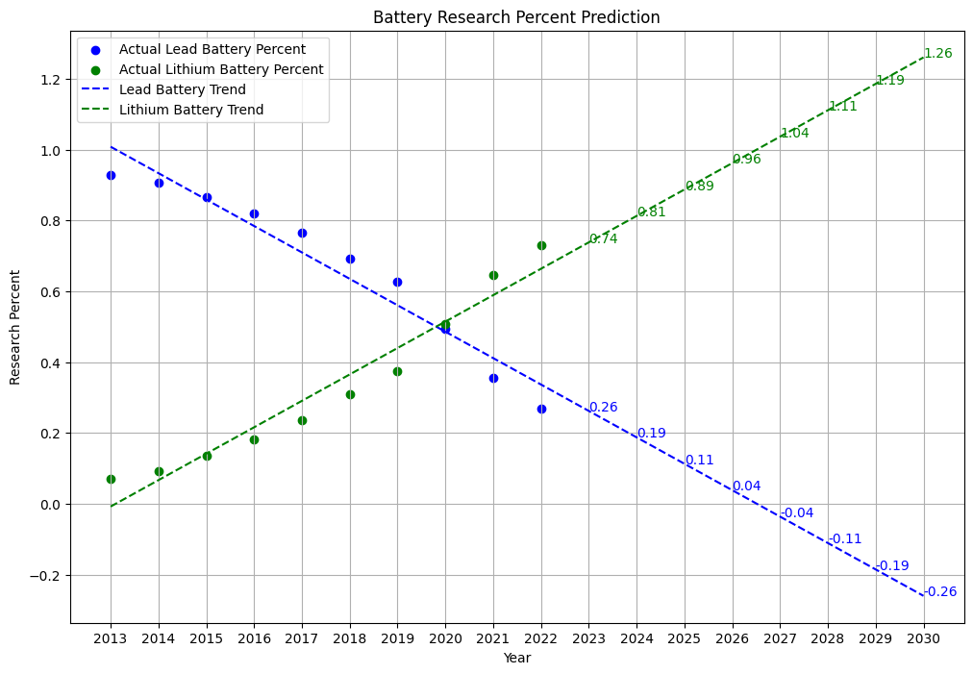
Varta Linear Regression
Regression is not the best fit as it over estimates the trends
Trends show slowdown in EV sales so this graph grossly overestimates

Slide 13
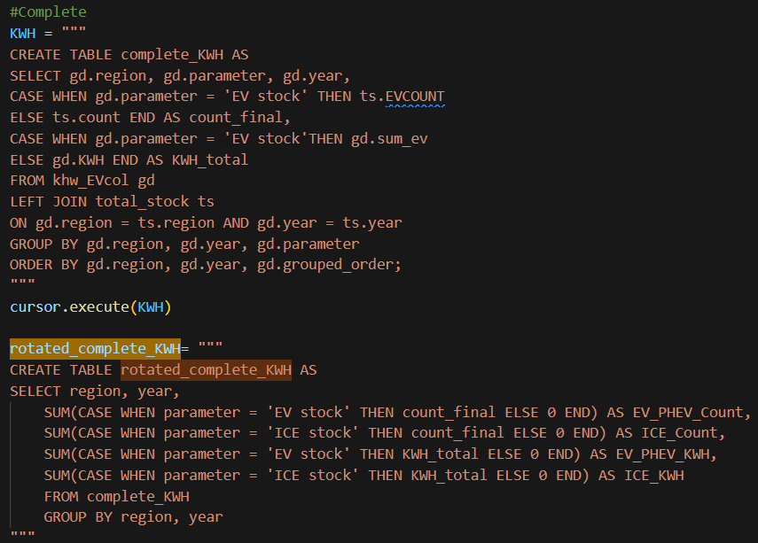
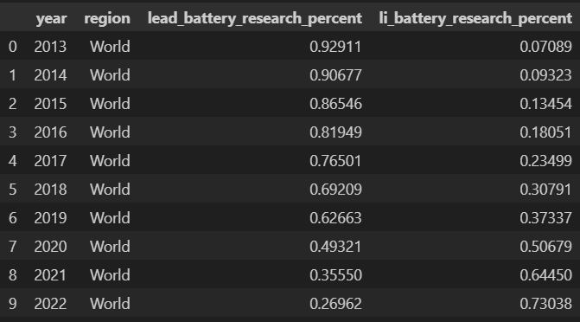
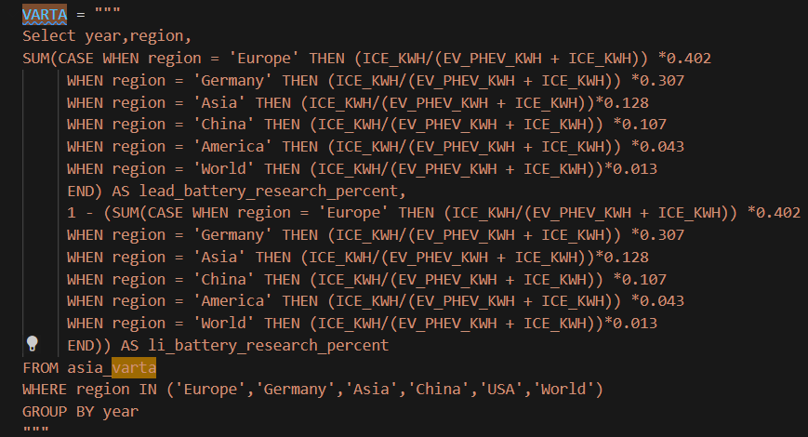
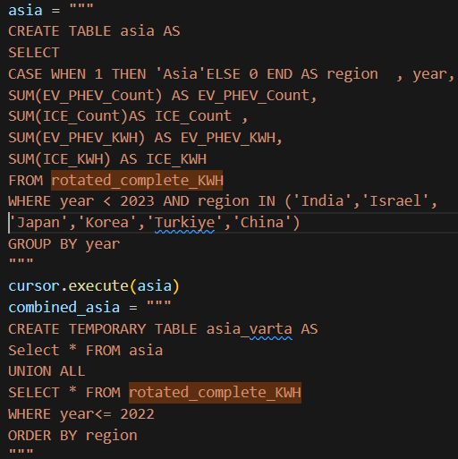
Code & Data
Precursor Queries:
Varta Research Ratio(Used for Graph):

Slide 14
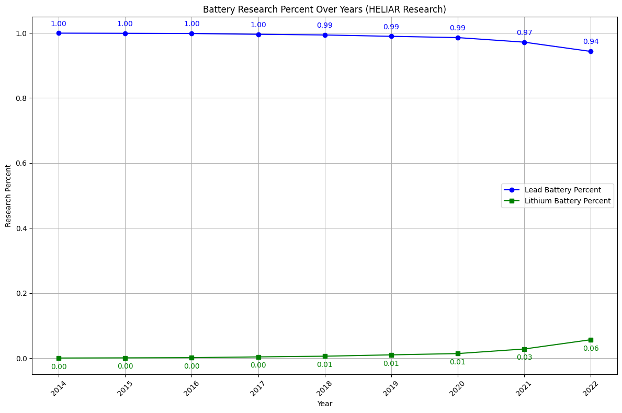
Heliar Research Ratio
We see that the electrification is not seen in the countries that Heliar sells to
Issues:
Not all South American countries are represented
Only Brazil and Chile
Rough representation but Brazil and Chile are most developed

Slide 15
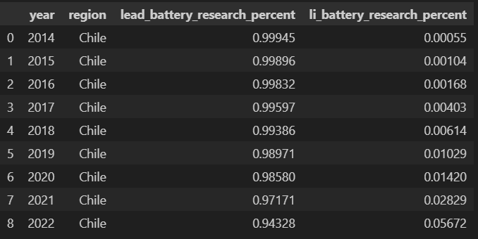
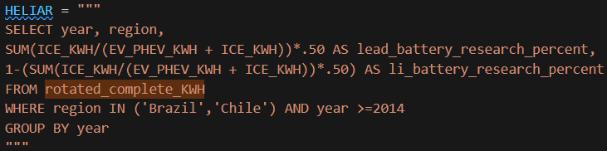
Code & Data
Precursor Queries:
Heliar Research Ratio(Used for Graph):

Slide 16
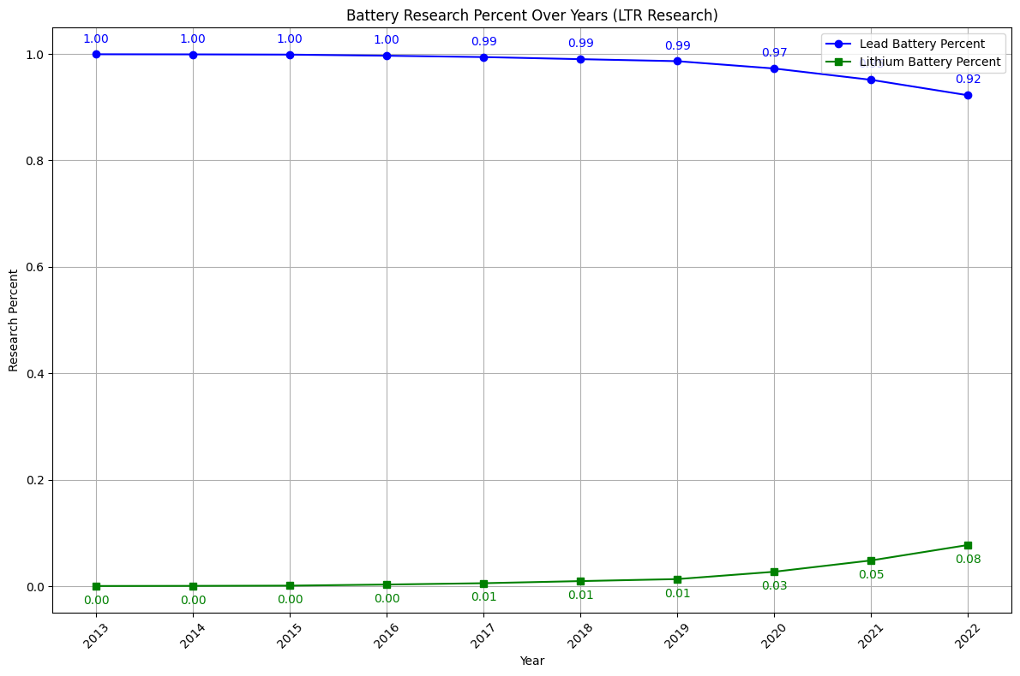
LTH Research Ratio
Similar findings with Heliar’s regions
Only Mexico no Central America
Code is same as Heliar just different regions selected

Slide 17
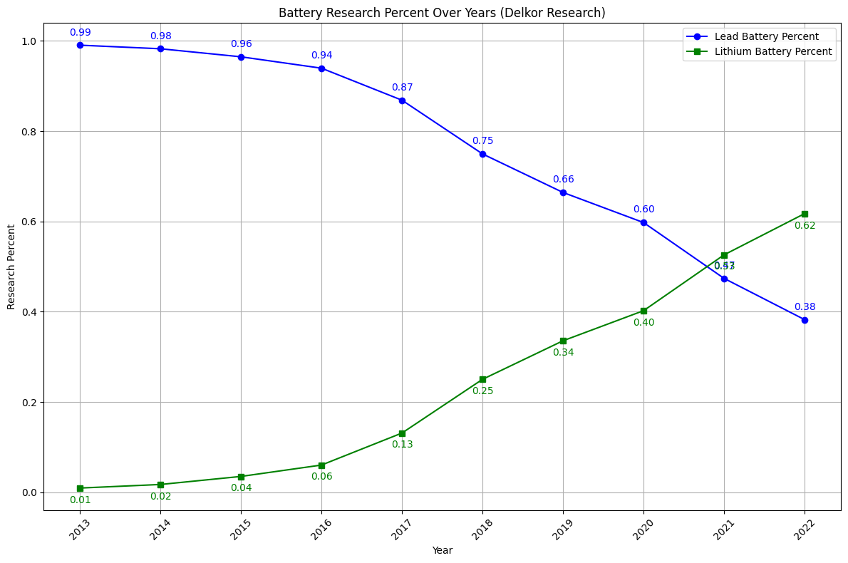
Delkor Research Ratio
Korea is significantly more electrified than Latin America
Same code just region is set to Korea

Slide 18

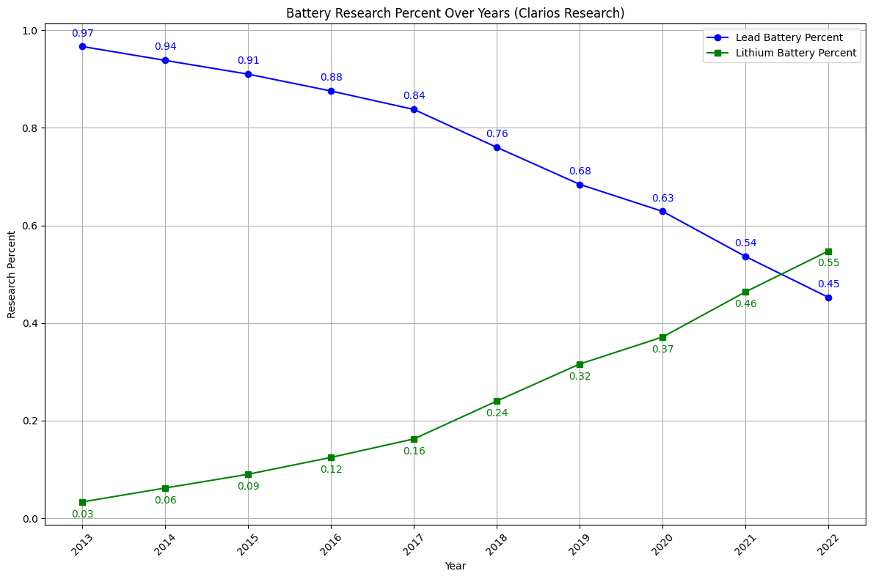
Clarios Research Ratio
Same code just region is set to US & Canada
Less lithium kwh than Korea but similar
Unsure if Optima or Clarios is brand in US

Slide 19
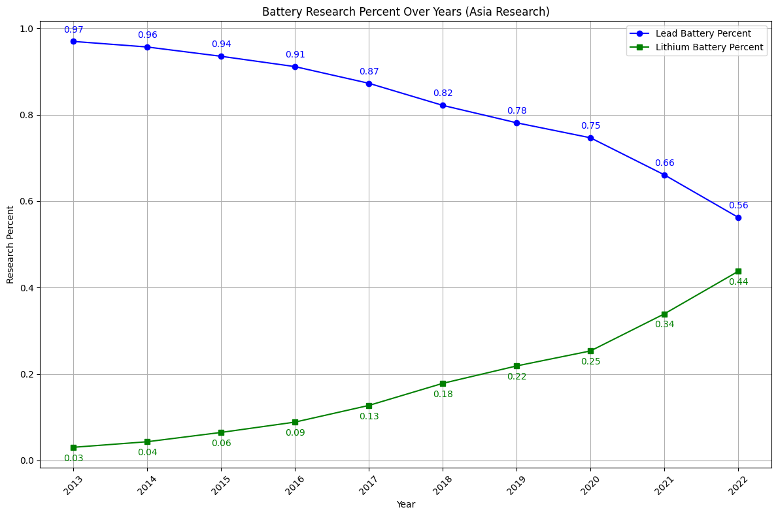
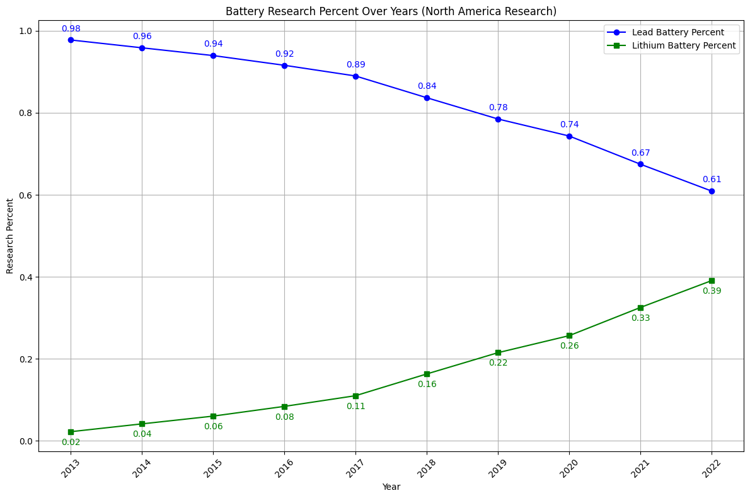
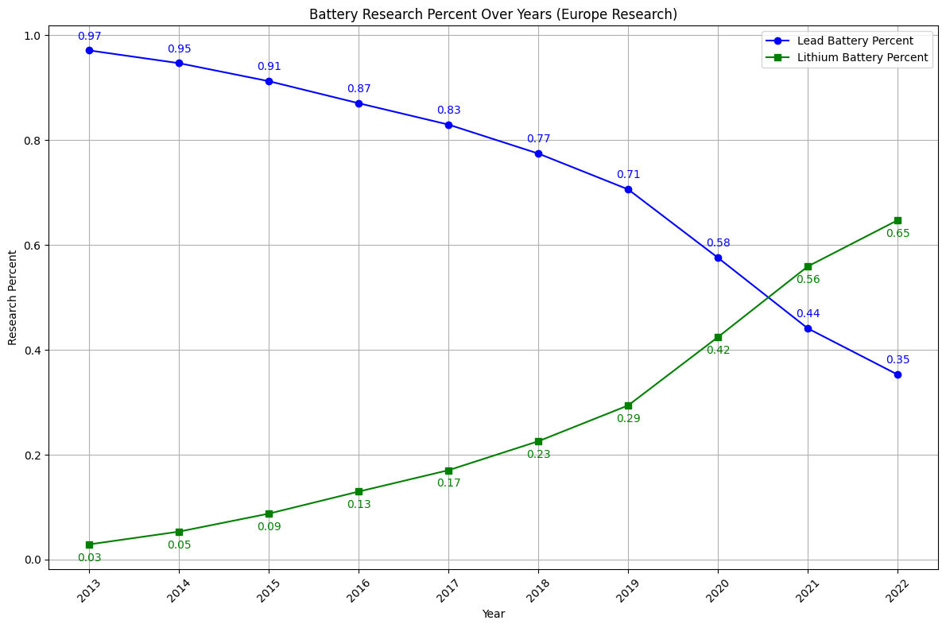
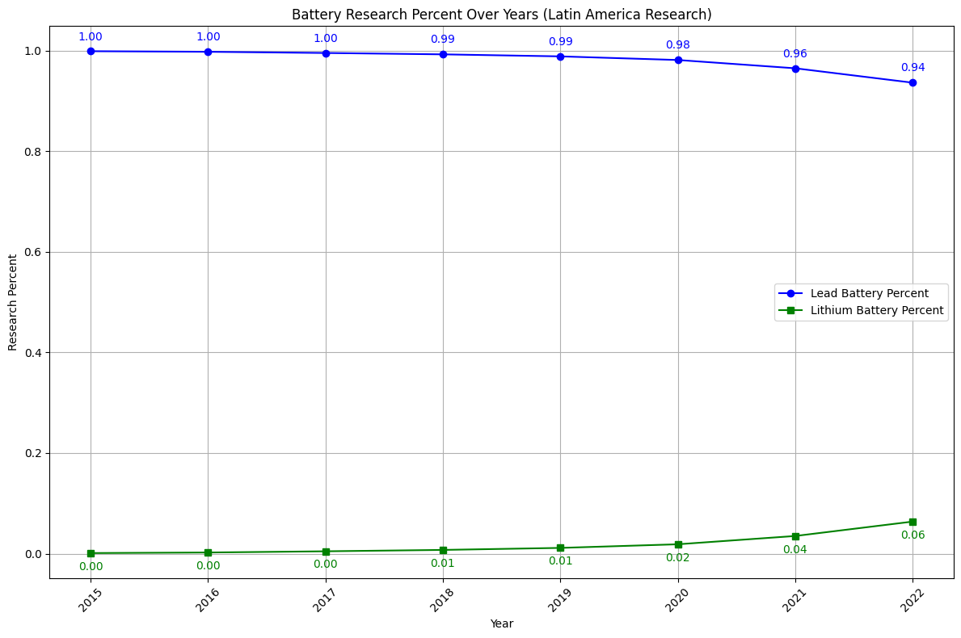
North America
Asia->
Europe
<-Latin America
Find more maps at slidescarnival.com/extra-free-resources-icons-and-maps

Slide 20
Issues With Project
Some regions lacked all the countries needed to represent it thoroughly
Battery assumption faults
KWH doesn't compare battery size properly 1 to 1
Battery averages doesn't change per region, i.e. US has larger battery packs than other countries
Battery averages is based on 2023 and doesn’t change throughout the years
Lithium Ion and Lead Acid don’t deserve the same amount of research as one is a newer technology

